Slide 1
OpSec
The Tradecraft of Securing Daily Life

Slide 2
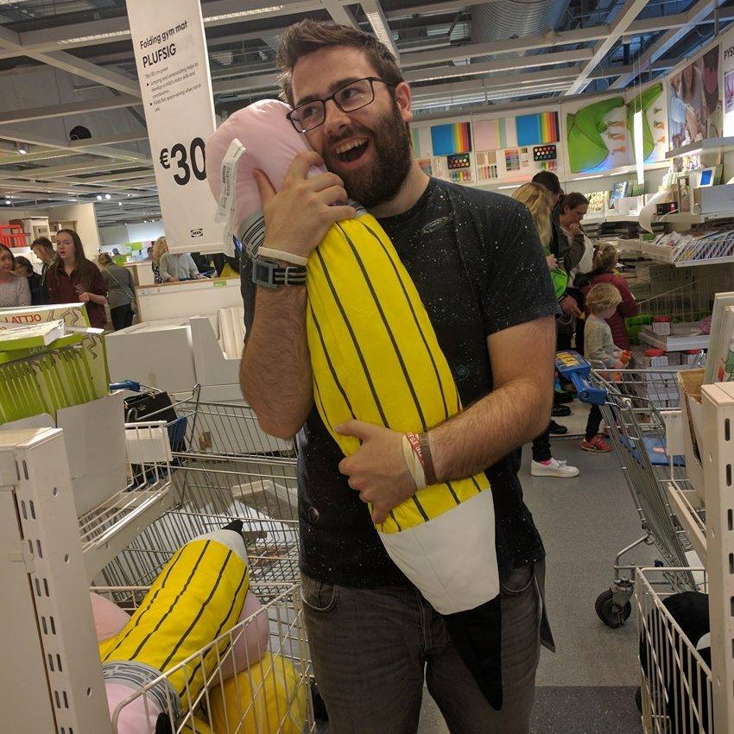
Why listen this eejit?
My previous job requred extensive OpSec as we were guranteed APT Targets
My new job is in OSINT finding OpSec errors and capitalising on them
I never shut up about OpSec

Slide 3
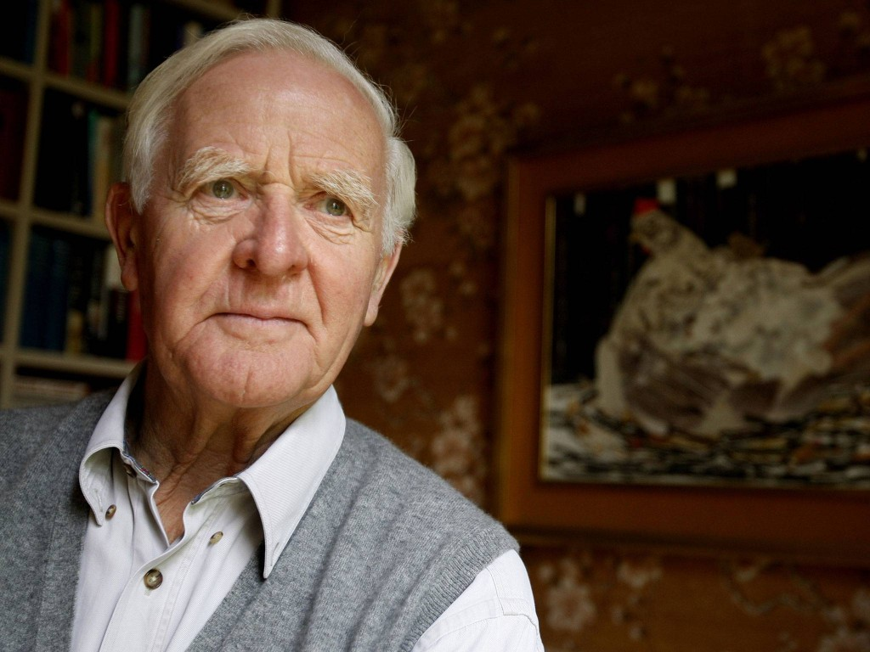
John le Carré
19 October 1933
Author/Novelist
OR
David John Moore Cornwell
19 October 1931
Intelligence Officer

Slide 4
Topics Covered
Intro
Methedology's
Techniques & Technologies
Examples
Conclusions
Resources

Slide 5
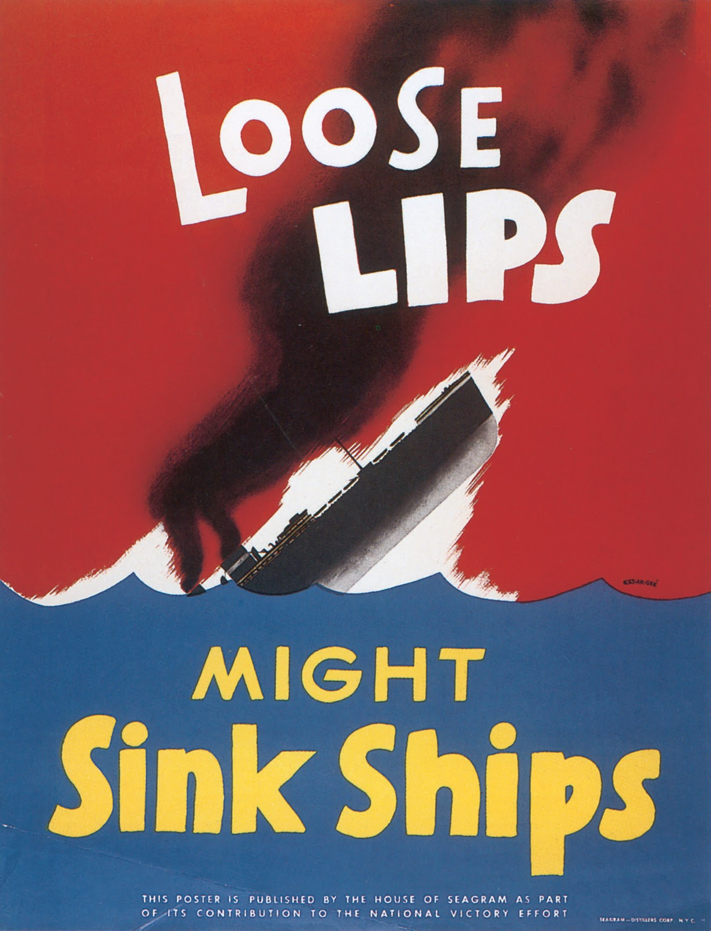
Intro to OpSec

Slide 6
What is it?
OPSEC is about minimizing attack surfaces and single points of failure through proper habits and policies.
OPSEC includes INFOSEC, COMSEC, TRANSEC, PHYSEC, APPSEC, NETSEC and all counter-intelligence.

Slide 7
WTFBBQ?!
Military and Intelligence term used in computer security and hacking. Also known as Tradecraft
In a nutshell;
Keeping your mouth shut
Guarding secrets
Following ‘need to know’
Not getting blackmailed
Break one law at a time

Slide 8
This seems ridiculous right?
Yes and no... We all do it, all the time
You leave you house, do you lock the door?
Why?
There's assests in there you want to protect
There's a threat, burgelry is a thing
There's a risk that you could loose assets to a burgler

Slide 9
It's not that hard, if done right
Be careful & be cool
Be relatively paranoid
Be Tidy
Don’t be explicit or use code
Camouflage is your friend

Slide 10
So what do we mean by all this?
Say your a Pot Smoker who wants to hide it
Chill man! Seriously! Don't freak out
You don't need to be paranoid but not that paranoid
Don't leave your paraphanalia lying around
Don't talk to your dealer in explicit terms or use obvious code
Don't dress like a stoner
Break one law at a time!

Slide 11
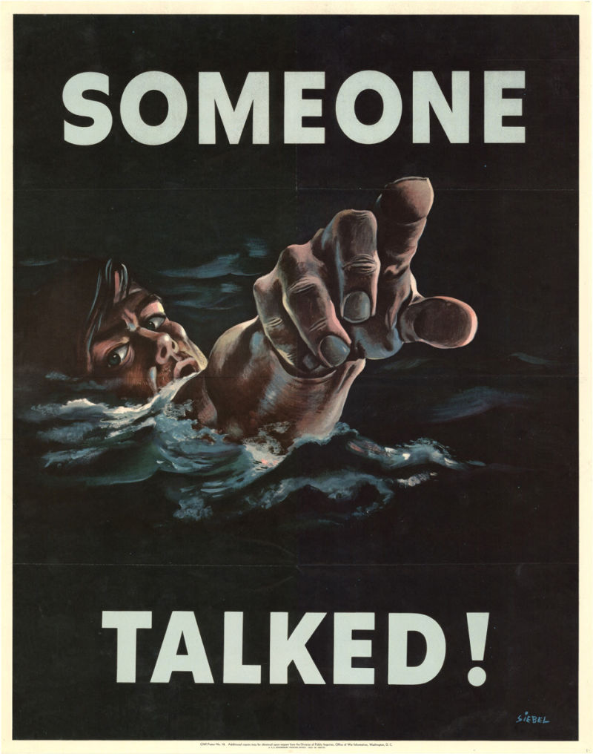
Methodology

Slide 12
Know the basics
Do your threat modeling
Analyse your risk
Legends
Follow the 10 OPSEC Commandments

Slide 13
Threat Modeling
To do a threat model, you must know some basic terminology
Asset - Anything of value that needs protection
Threat - Events that undermine defensive efforts
Risk - The chance that threats succeed and assets are exposed

Slide 14
Threat Modeling
Do it the good old Cold War way!
Know what assets to protect
Know who to protect them from
Know how exposed assets are to attack
Know how much trouble you will go through to protect assets
Know the price of failure

Slide 15
How to Threat Model
MAKE A PAPER LIST!
List your assets
List the threats to the assets
Know the capability of your adversaries
Know the risk of attack
Do a risk analysis; know your likleyhood of failure

Slide 16
Risk Analysis
Knowing how much effort to put into defending assets
Know what to take seriously
Know the ways you can loose assets
Ignore the harmless, the rare and the impossible to combat

Slide 17
How do you even!?
You work for Government CERT
Assets are documents, comms, staff records
Your threats are espionage and APT's
Everything is potentially exposed since your adversary is the most capable
Failure is immense. The loss of a negoition advantage, failed peace deals or worse, civilian deaths
There is a near 100% chance of failure without action to protect assets

Slide 18
Legends
A well prepared and credible made-up identity
4 major components;
An Alias
A history
A background
Supporting documentation
IN THAT ORDER

Slide 19
Using Legends
Never contaminate legends. It will give you away if they communicate
When a Legend is burnt, start again. Your safe, but you non existant cover isn't
Pratice it! If you don't want to make a mistake, know your Legend like you know you and know when to use it

Slide 20
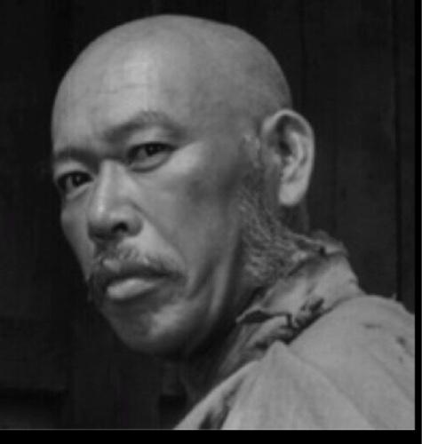
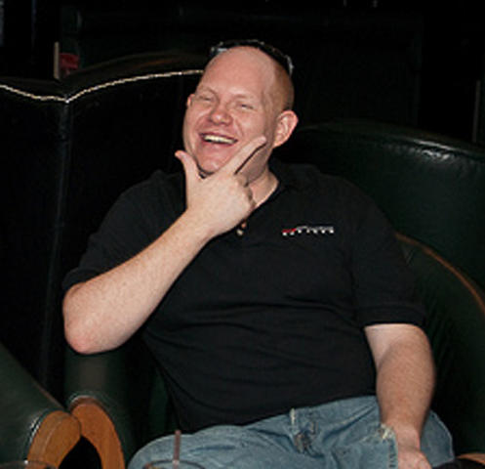
People don't seriously do this do they?!
The guy is 'thegrugq' a security researcher and anti-froensics expert, and it's a carefully crafted legend with all the elements, even an active online prescence.
The bottom image is thegrugq IRL

Slide 21
The 10 Commandments pt 1
Never reveal opperational detail
Never reveal your plans
Never trust anyone
Only use secure communications methods for opperational comms
Never opperate from your own house

Slide 22
The 10 Commandments pt 2
Be proactively paranoid. You can't be retroactively paranoid
Never confuse recreation and opperations
Keep your personal enviroment controband free
Don't talk to the Guards/Police
Don't give anyone power over you

Slide 23
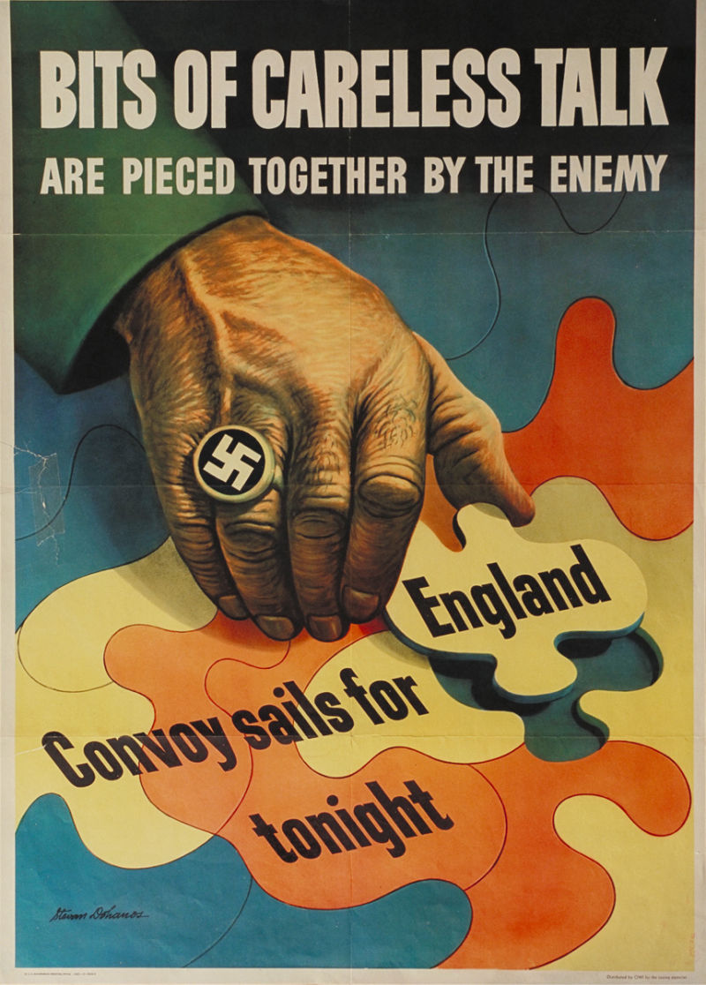
Techniques & Technology

Slide 24
Physical Techniques
Know multiple routes to any place
Don't get trapped
Use Dead Mans Switches

Slide 25
Digital Technqies
Don't store encriminating data locally
Encrypt, encrypt, encrypt! Espescially at rest
Use paper! Seriously. Burns better than a SSD, HDD or USB stick

Slide 26
Physical Technology
Faraday Wallets
Faraday backpacks
IR reflective clothing

Slide 27
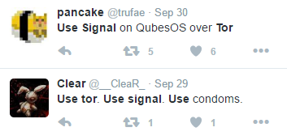
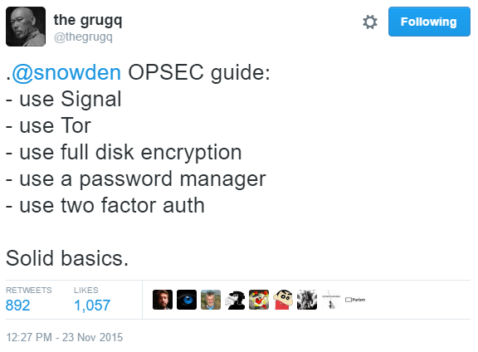
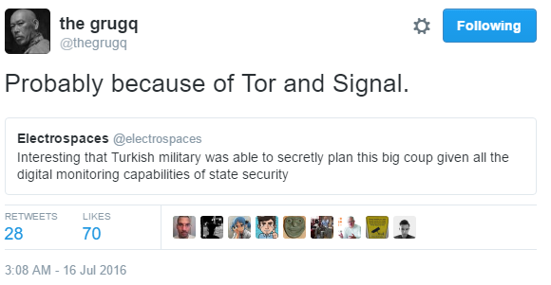
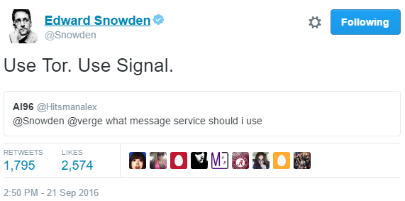
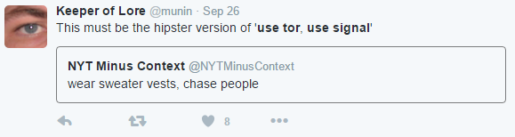
Digital Technology

Slide 28
Digital Technology
Use Tor, Use Signal
U2F all the things
ZRTP for VoIP
OTR for text
TrueCrypt/VeraCrypt for data at rest
PGP for email
And I can't say this enough. Telegram can FUCK RIGHT OFF. It's not secure.

Slide 29
Profiling Data aka Metadata
Data about data. Better than content
Most people are worried about someone listening to your phone calls but that doesn't yeild much data
Metadata does. It allows you to build networks of who your friends family and contacts are

Slide 30
The Facebook Microphone Controversy
Last week it surfaced that facebook listened to your mic to serve ads. This isn't true but people think it is
Facbook uses a combination of tracking though a technology called Pixel to collect metadata on you.
It didn't have to listen to your mic when you give it the data it needs by using the internet
It doesn't need your mic to know what you want

Slide 31
Reducing your fingerprint to metadata
Log out of services like Google and Facebbook that track you across the web
uBlock Origin OR Disconnect to block ads
Privacy Badger block trackers
Cookie AutoDelete to delete cookies
HTTPS Everywhere to enxrypt connections
DuckDuckGo for searching for stuff

Slide 32
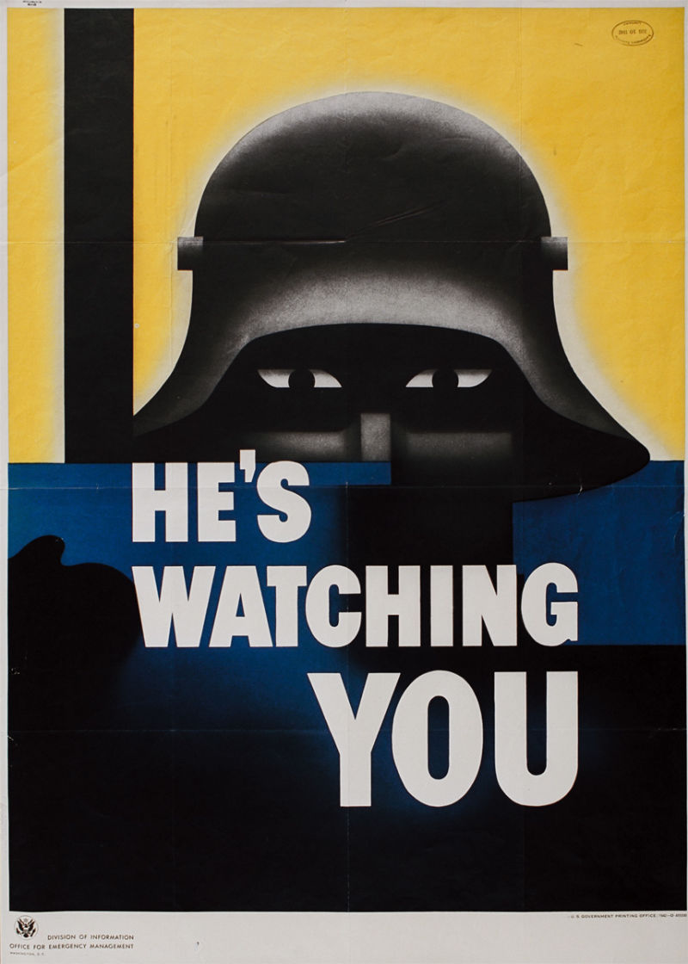
Examples

Slide 33
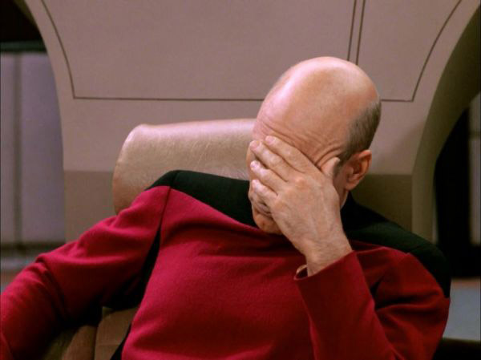
Irish mammy hax0r edition
My mam got a new tablet for christmas and wanted to take security seriously
10 mins later she forgot the password manager master password.
She got a password manager, set up new accounts with long passwords

Slide 34
Lessons Learned?
Secrets aren't very secret if you can't remember them!
Taking security and OpSec seriously isn't a thing you can do in 5 mins and forget about

Slide 35
Weev
Blackhat who found a flaw in AT&T System. Open legel qustion if it was actually illegal
Busted by FBI for having drugs, then convicted of hacking becasue the warrant for drugs allowed them to search his computers

Slide 36
Lessons Learned?
Break one law at a time
Don't mix business and pleasure
Don't continate your workplace

Slide 37
LulzSec and Sabu
LulzSec actually did a really good job of OpSec which is rare for Hactivist groups
Except it's leader Sabu was an FBI informant who sold out everyone else and got the lot arrested

Slide 38
Lessons Learned?
Trust no one

Slide 39
Jake's CTF
Jake, our local social engineer was doing a CTF for the Watchdogs game and was having some trouble. After consulting the leaderboard, he noticed our friends at InSecurity a Frence CTF team had the answers jake needed

Slide 40
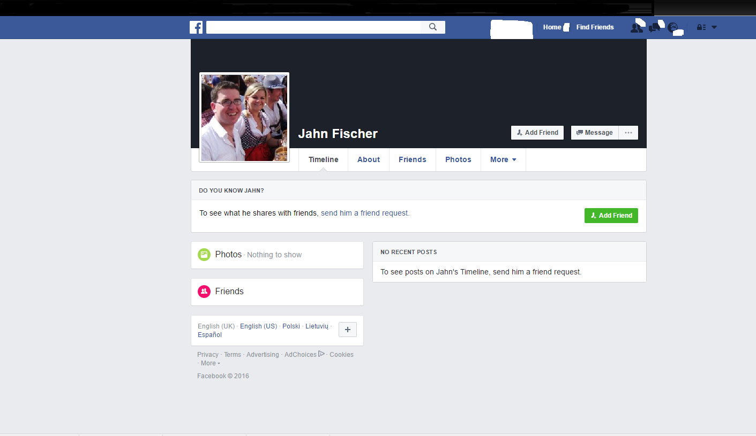
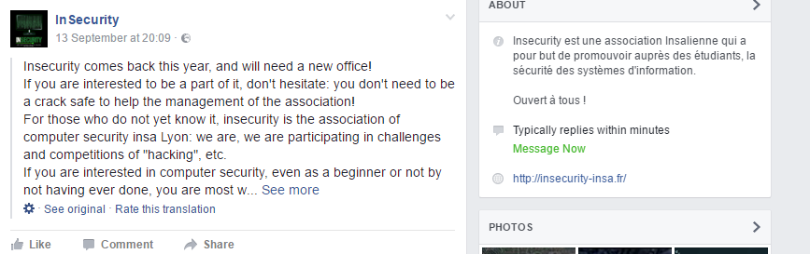
Jake set up a legend, "Jahn Fischer", a German exchange student at the same University as InSecurity

Slide 41

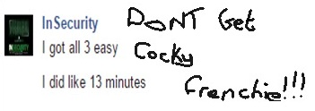
"Jahn" joined the team and was given the answers with some background information including a humble brag

Slide 42
Lessons Learned?
Well implemented OpSec can be used to great effect when peope:
Reveal opperational detail
Reveal their plans
Blindly trust you
Aren't proactively paranoid
ie When others don't follow the 10 commandments

Slide 43
Some of my work with the USAF
So as part of my work, I track a plane called a Cobra Ball. Cobra Balls missions are highly classified by the US Air Force
Some times they make mistakes at takeoff and becasue of this mistake I can track them as they fly

Slide 44
In September a Cobra Ball took off and made an OpSec error that allowed us to track his plane via radio using the callsign "CLIP SHOT" and we could triangulate his possition in the skies over Japan using listening posts we have set up in Japan. All becasue the pilot/co pilot/Engineer left on an ADS-B Transponder for a split second and made one radio call while they were the only US Plane in the skies
Why use RADAR to track planes when the plane lets you track it via other means?

Slide 45
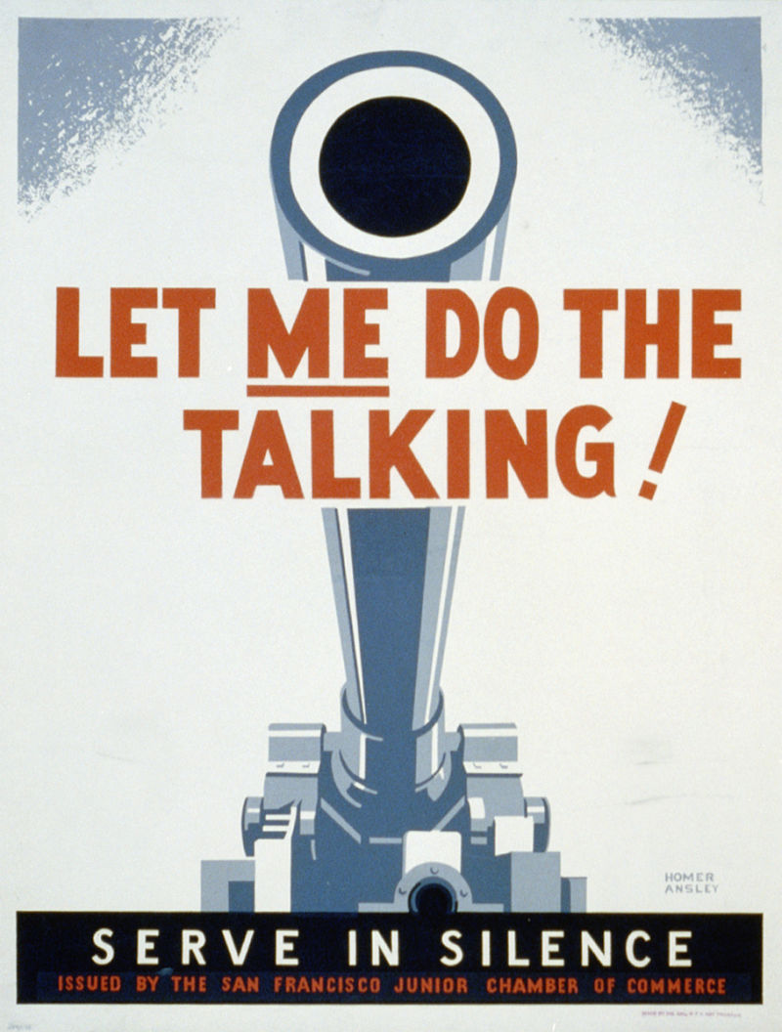
Conclusions & Resources

Slide 46
Know the basics
Do your threat model
Do your risk analysis
Make your Legends
Know your Legends
Remember the 10 Commandments
Remember the Techniques and Technologies to help you get by

Slide 47
Resources;
EFF SSD: ssd.eff.org
The works of thegrugq, Edward Snowden, Pwn All the Things, Christopher Soghoian and the Staff at the EFF as well as CCC, HOPE, DerbyCon, BlackHat & Defcon presentations and DoDM 5205.02-M
Google is not your friend for OpSec. Find real sources like field manuals from professionals

Slide 48
Questions?

